Slide 1
Module 4

Slide 2
Introduction to Cyber Security
Need of Cyber Security,
Types of Cyberattacks:
Cyber Attacks against individuals,
Cyber Attacks against organization,
Cyber Attacks against Society

Slide 3
Cybersecurity is the ongoing effort to protect individuals, organizations and governments from digital attacks by protecting networked systems and data from unauthorized use or harm.

Slide 4
On a personal level, you need to safeguard your identity, your data, and your computing devices.

Slide 5
At an organizational level, it is everyone’s responsibility to protect the organization’s reputation, data and customers.

Slide 6
As more digital information is being gathered and shared, its protection becomes even more vital at the government level, where national security, economic stability and the safety and wellbeing of citizens are at stake.

Slide 7
Need of Cyber Security
Protection of Sensitive Data: Cybersecurity measures safeguard sensitive information such as personal data, financial records, intellectual property, and trade secrets from unauthorized access, theft, or exploitation. Protecting data privacy and confidentiality is crucial for maintaining trust with customers, partners, and stakeholders.

Slide 8
Prevention of Financial Losses: Cybersecurity helps prevent financial losses resulting from data breaches, ransomware attacks, fraudulent transactions, and online scams. Investing in robust security controls and incident response capabilities can mitigate the risks of financial fraud and theft, saving organizations from significant monetary damages.

Slide 9
Preservation of Business Continuity: Cybersecurity measures ensure the resilience and availability of critical systems, networks, and services, even in the face of cyberattacks, natural disasters, or technical failures. Implementing disaster recovery plans, backup solutions, and redundancy measures helps organizations maintain business continuity and minimize downtime.

Slide 10
Protection of Intellectual Property: Cybersecurity safeguards intellectual property (IP) assets such as proprietary software, product designs, research findings, and creative works from unauthorized disclosure, theft, or counterfeiting. Protecting IP rights is essential for fostering innovation, competitiveness, and sustainable growth in the digital economy.

Slide 11
Mitigation of Reputation Risks: Cybersecurity helps mitigate reputation risks arising from data breaches, security incidents, or compliance violations that may damage an organization's brand, credibility, and trustworthiness. Establishing a strong cybersecurity posture and transparent communication can enhance customer confidence and stakeholder trust.

Slide 12
Compliance with Regulatory Requirements: Cybersecurity ensures compliance with industry regulations, data protection laws, and privacy regulations governing the collection, storage, and processing of sensitive information. Adhering to regulatory requirements helps organizations avoid legal liabilities, regulatory fines, and reputational damage resulting from non-compliance.

Slide 13
Protection of Critical Infrastructure: Cybersecurity safeguards critical infrastructure systems such as power grids, transportation networks, healthcare facilities, and financial services from cyber threats that could disrupt essential services, endanger public safety, and undermine national security. Securing critical infrastructure is vital for ensuring resilience and continuity in the face of evolving threats.

Slide 14
Defense Against Cyber Warfare: Cybersecurity capabilities play a crucial role in defending against cyber warfare tactics employed by nation-state actors, terrorist organizations, and hostile adversaries seeking to disrupt government operations, economic activities, and strategic interests. Strengthening cyber defenses and fostering international cooperation are essential for deterring cyber aggression and preserving global stability.

Slide 15
Protection of Personal Privacy: Cybersecurity safeguards individuals' privacy rights and personal data from unauthorized surveillance, tracking, or exploitation by cybercriminals, advertisers, and government agencies. Upholding privacy principles such as consent, transparency, and data minimization is essential for respecting individuals' autonomy and dignity in the digital age.

Slide 16
Promotion of Trust and Confidence: Cybersecurity fosters trust, confidence, and resilience in digital ecosystems by promoting cybersecurity awareness, education, and best practices among individuals, organizations, and communities. Building a culture of cybersecurity empowers stakeholders to proactively address cyber risks and collaborate effectively in combating cyber threats.

Slide 17
Cyber Attacks against individuals
Phishing: Attackers send deceptive emails or messages, impersonating legitimate organizations or individuals, to trick recipients into providing sensitive information like passwords or financial details.

Slide 18
Malware: Malicious software, such as viruses, worms, trojans, and spyware, can infect individuals' devices, compromising their security and privacy. Malware can be distributed through email attachments, infected websites, or malicious downloads.

Slide 19
Ransomware: This type of malware encrypts victims' files or locks them out of their devices, demanding a ransom payment in exchange for restoring access. Ransomware attacks can have severe consequences for individuals who may lose access to important data or face financial losses.

Slide 20
Identity Theft: Cybercriminals steal personal information, such as social security numbers, credit card details, or login credentials, to impersonate individuals or commit fraud in their name. This stolen information is often obtained through data breaches, phishing scams, or social engineering tactics.

Slide 21
Social Engineering: Attackers manipulate individuals into revealing sensitive information or performing actions that compromise their security. Social engineering techniques include pretexting, baiting, and they often exploit human psychology and trust to deceive victims.

Slide 22
Sextortion: Cybercriminals coerce individuals into performing sexual acts or sharing intimate images, threatening to distribute compromising material if their demands are not met. Sextortion attacks can have devastating emotional and reputational consequences for victims.

Slide 23
Online Scams: Individuals may fall victim to various online scams, including lottery scams, romance scams, and tech support scams. These scams aim to deceive individuals into sending money or providing personal information under false pretenses.

Slide 24
Credential Stuffing: Attackers use stolen usernames and passwords obtained from data breaches to gain unauthorized access to individuals' accounts on various online platforms. Credential stuffing attacks exploit the practice of reusing passwords across multiple accounts.

Slide 25
Cyberbullying: Individuals may experience harassment, intimidation, or humiliation through online platforms, social media, or messaging apps. Cyberbullying can have serious psychological and emotional effects on victims and may escalate to more severe forms of harassment.

Slide 26
Mobile Device Exploitation: Attackers target vulnerabilities in smartphones and tablets to steal personal data, track users' activities, or remotely control their devices. Malicious mobile apps, fake Wi-Fi networks, and SMS phishing are common tactics used in mobile device exploitation attacks.

Slide 27
CyberAttacks against organization
Phishing Attacks: Cybercriminals send deceptive emails or messages to employees, posing as legitimate entities or individuals, to trick them into revealing sensitive information such as login credentials or financial details. Phishing attacks can also target executives or employees with access to valuable company data.
Ransomware: This type of malware encrypts files on the organization's network or locks employees out of their devices, demanding a ransom payment in exchange for restoring access. Ransomware attacks can disrupt business operations, cause data loss, and result in financial losses if organizations choose to pay the ransom.
Distributed Denial of Service (DDoS) Attacks: Attackers flood the organization's network or website with a large volume of traffic, overwhelming its capacity and causing it to become unavailable to legitimate users. DDoS attacks can disrupt online services, leading to downtime and financial losses for organizations.

Slide 28
Insider Threats: Malicious insiders or disgruntled employees may intentionally sabotage the organization's systems, steal sensitive data, or leak confidential information to external parties. Insider threats can be challenging to detect and mitigate, as perpetrators often have legitimate access to the organization's resources.
Data Breaches: Cybercriminals gain unauthorized access to the organization's systems or databases, compromising sensitive information such as customer data, intellectual property, or financial records. Data breaches can have severe consequences for organizations, including regulatory fines, legal liabilities, and damage to their reputation.
Advanced Persistent Threats (APTs): Sophisticated adversaries, such as nation-state actors or organized cybercrime groups, conduct long-term targeted attacks against organizations to steal valuable data or disrupt their operations. APTs often involve multiple stages and use advanced techniques to evade detection by traditional security measures.

Slide 29
Malware Infections: Organizations may fall victim to various types of malware, including viruses, worms, trojans, and spyware, which can infect their systems and compromise their security. Malware infections can result in data loss, financial fraud, and unauthorized access to sensitive information.
Supply Chain Attacks: Cybercriminals target third-party vendors or suppliers with access to the organization's network or systems, exploiting vulnerabilities in their infrastructure to gain unauthorized access or distribute malware. Supply chain attacks can compromise the entire ecosystem of interconnected organizations and lead to widespread data breaches.
Credential Theft: Attackers steal employees' login credentials through various means, such as phishing, keylogging, or brute-force attacks, to gain unauthorized access to the organization's systems or sensitive information. Credential theft can result in data breaches, financial fraud, and identity theft.
Zero-Day Exploits: Attackers exploit previously unknown vulnerabilities in software or hardware components used by the organization to gain unauthorized access or execute malicious code. Zero-day exploits can bypass traditional security defenses and cause significant damage before patches or updates are available to mitigate the risk.

Slide 30
CyberAttacks against Society
Critical Infrastructure Attacks: Cybercriminals or nation-state actors target essential infrastructure systems such as power grids, water treatment facilities, transportation networks, and healthcare systems. These attacks can disrupt vital services, cause widespread chaos, and pose significant risks to public safety and national security.
Disinformation Campaigns: State-sponsored actors, political groups, or malicious entities spread false information or propaganda through social media, news websites, or online forums to manipulate public opinion, sow discord, and undermine trust in democratic institutions. Disinformation campaigns can exacerbate social divisions, incite violence, and undermine democracy.
Cyber Terrorism: Extremist groups or terrorist organizations conduct cyberattacks against government agencies, financial institutions, or critical infrastructure systems to cause disruption, instill fear, and achieve political or ideological objectives. Cyber terrorist attacks can have catastrophic consequences, resulting in loss of life, economic damage, and societal instability.

Slide 31
Mass Surveillance: Government agencies or malicious actors engage in large-scale surveillance activities to monitor individuals' communications, online activities, and personal data without their consent or knowledge. Mass surveillance poses threats to privacy rights, civil liberties, and freedom of expression, undermining trust in democratic societies and fostering a culture of surveillance.
Cyber Warfare: Nation-state actors engage in cyber warfare tactics, including espionage, sabotage, and cyberattacks, to gain strategic advantage, undermine adversaries, or achieve geopolitical objectives. Cyber warfare can escalate tensions between nations, trigger diplomatic crises, and lead to retaliatory actions in the physical or digital domain.
Financial Crimes: Cybercriminals conduct various forms of financial fraud, including online banking scams, credit card fraud, identity theft, and cryptocurrency-related crimes. Financial crimes can result in substantial financial losses for individuals, businesses, and governments, undermining economic stability and consumer confidence.

Slide 32
Cyber Espionage: Nation-state actors or corporate spies conduct covert cyber espionage operations to steal sensitive information, intellectual property, or trade secrets from governments, corporations, or research institutions. Cyber espionage threatens national security, economic competitiveness, and technological innovation, jeopardizing the integrity of democratic societies and global supply chains.
Cyberbullying and Online Harassment: Individuals or groups engage in cyberbullying, harassment, or online abuse targeting vulnerable populations, including children, teenagers, minorities, and marginalized communities. Cyberbullying can have severe psychological and emotional effects on victims, leading to depression, anxiety, and even suicide in extreme cases.

Slide 33
Online Extortion: Cybercriminals use threats, intimidation, or coercion to extort money or valuables from individuals, businesses, or organizations by leveraging sensitive information or compromising materials obtained through cyberattacks. Online extortion tactics can exploit victims' fears, vulnerabilities, or reputational risks, causing significant financial and psychological harm.
Cyberattacks on Healthcare Systems: Cybercriminals target healthcare organizations, hospitals, and medical facilities with ransomware, data breaches, or disruptive attacks, compromising patient data security, disrupting healthcare services, and jeopardizing patient safety. Cyberattacks on healthcare systems can have life-threatening consequences, especially during public health crises or emergencies.

Slide 34
It’s your first day on the job, and it’s time to choose a username for your online identity. Which of the following options would you choose?
This is your first chance to gain some valuable defender points at eLearning company @Apollo, so take your time and think carefully before making your choices.

Slide 35
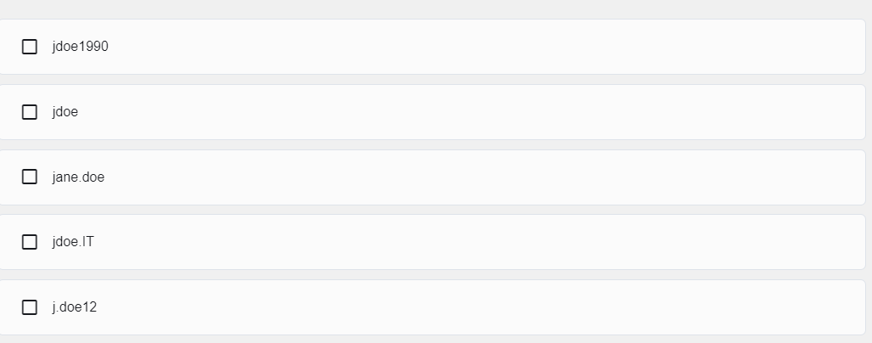

Slide 36
When choosing a username, it’s important not to reveal any personal information.
Some other useful tips to help you generate your username:
Don’t use your full name or parts of your address or phone number.
Don’t use your email username.
Don’t use the same username and password combination, especially on financial accounts.
Don’t choose a super-odd username and then reuse it again and again — it makes you easier to track.
Don’t choose a username that gives clues to your passwords such as a series of numbers/letters, the first part of a two-part phrase,
such as knock-knock or starlight, or the department in which you work, such as IT.
Do choose a username that’s appropriate for the type of account, i.e., business, social or personal.
Go back, reset and have another try.

Slide 37
Personal data describes any information about you, including your name, social security number, driver license number, date and place of birth, your mother’s maiden name, and even pictures or messages that you exchange with family and friends.
Cybercriminals can use this sensitive information to identify and impersonate you, infringing on your privacy and potentially causing serious damage to your reputation.

Slide 38
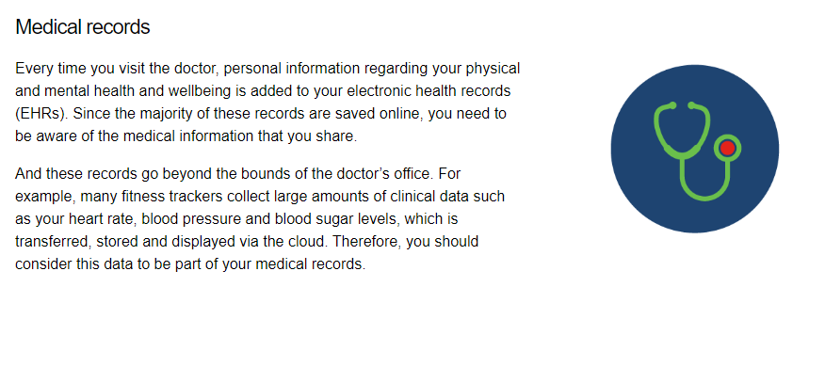

Slide 39
Traditional data is typically generated and maintained by all organizations, big and small. It includes the following:
Transactional data such as details relating to buying and selling, production activities and basic organizational operations such as any information used to make employment decisions.
Intellectual property such as patents, trademarks and new product plans, which allows an organization to gain economic advantage over its competitors. This information is often considered a trade secret and losing it could prove disastrous for the future of a company.
Financial data such as income statements, balance sheets and cash flow statements, which provide insight into the health of a company.

Slide 40
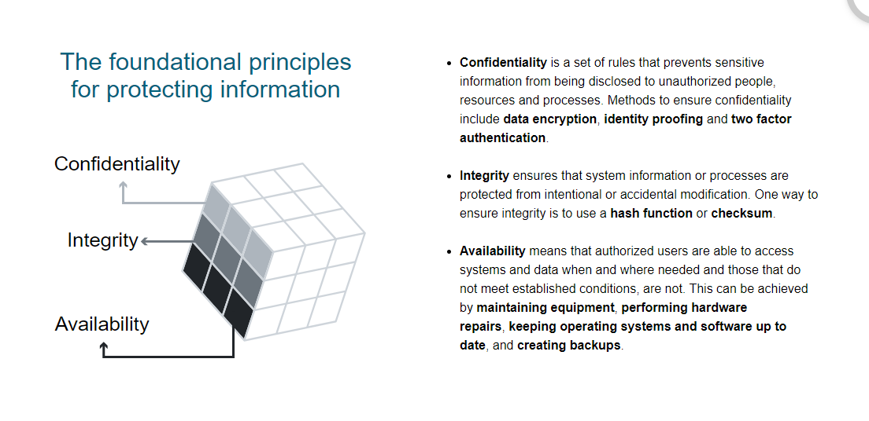

Slide 41
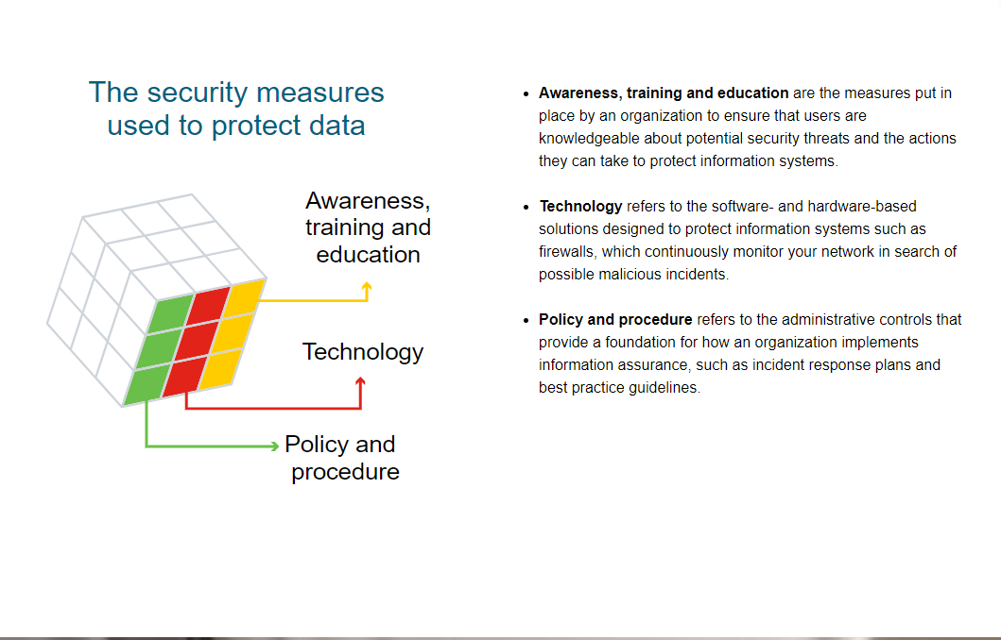

Slide 42
Every organization is at risk of a cyber attack and therefore must take appropriate action to protect itself.
Thinking back to each of the two security breach examples outlined above, what measures could these organizations have implemented in order to have prevented these security breaches?

Slide 43
Scenario 1
a well known hotel chain that operates across the world has reported a massive data breach, with the personal information of over three million guests exposed to hackers.
The hotel discovered that hackers gained access to its customer database by using the login details of one of its employees.
At this point, the hotel doesn’t believe that the hackers were able to access any account passwords or financial information. Recent guests are encouraged to check the hotel chain’s web portal to see if they have been impacted by this breach.

Slide 44
Senario 2
A popular online training platform admitted leaving the personal data of millions of its students (many of them minors) exposed on a publicly accessible cloud database.
Hackers were able to directly access students’ full names, email addresses, phone numbers, and school enrollment details from the Internet!
While it’s unclear what the hackers have done with this acquired information, it’s safe to say that they have everything they need to carry out widespread phishing or malware attacks.

Slide 45
In both cases, the organizations need to invest in improved security practices.
This might include:
investing in cybersecurity training for all staff so that they are aware of and able to spot a cyber attack
enforcing two factor authentication for employees accessing files and applications that contain sensitive data
maintaining log files and ongoing monitoring to identify anomalous behavior that might indicate a data breach
storing the passwords of customers using a combination of salting and robust hashing algorithms
separating cloud-based resources from the public Internet into an isolated private network segment
granting employee access to personal data and internal systems only via a secure VPN connection.

Slide 46
Task 1
Search for a few additional examples of recent security breaches. In each case, can you identify:
what was taken?
what exploits the attackers used?
what actions could be taken to prevent the breach from occurring again in the future?

Slide 47
Attackers are individuals or groups who attempt to exploit vulnerability for personal or financial gain. As we’ve already seen, they are interested in everything, from credit cards to product designs!

Slide 48
Let’s look at some of the main types of cyber attackers who’ll try anything to get their hands on our information. They are often categorized as white hat, gray hat or black hat attackers.

Slide 49
Amateurs
The term 'script kiddies' emerged in the 1990s and refers to amateur or inexperienced hackers who use existing tools or instructions found on the Internet to launch attacks. Some script kiddies are just curious, others are trying to demonstrate their skills and cause harm. While script kiddies may use basic tools, their attacks can still have devastating consequences.

Slide 50
Hackers
This group of attackers break into computer systems or networks to gain access. Depending on the intent of their break in, they can be classified as white, gray or black hat hackers.
White hat attackers break into networks or computer systems to identify any weaknesses so that the security of a system or network can be improved. These break-ins are done with prior permission and any results are reported back to the owner.
Gray hat attackers may set out to find vulnerabilities in a system but they will only report their findings to the owners of a system if doing so coincides with their agenda. Or they might even publish details about the vulnerability on the internet so that other attackers can exploit it.
Black hat attackers take advantage of any vulnerability for illegal personal, financial or political gain.

Slide 51
Organized hackers
These attackers include organizations of cyber criminals, hacktivists, terrorists and state-sponsored hackers. They are usually highly sophisticated and organized, and may even provide cybercrime as a service to other criminals.
Hacktivists make political statements to create awareness about issues that are important to them.
State-sponsored attackers gather intelligence or commit sabotage on behalf of their government. They are usually highly trained and well-funded and their attacks are focused on specific goals that are beneficial to their government.

Slide 52
Cyberwarfare, as its name suggests, is the use of technology to penetrate and attack another nation’s computer systems and networks in an effort to cause damage or disrupt services, such as shutting down a power grid.

Slide 53
Security vulnerabilities are any kind of software or hardware defect.
A program written to take advantage of a known vulnerability is referred to as an exploit.
A cybercriminal can use an exploit against a vulnerability to carry out an attack, the goal of which is to gain access to a system, the data it hosts or a specific resource.

Slide 54
constantly aware of security vulnerabilities around you so that you can respond accordingly. But remember, the cybersecurity landscape is continually evolving. For example, cryptojacking — a type of cyber attack used to mine cryptocurrency — is on the rise.

Slide 55
Cryptocurrency is digital money that can be used to buy goods and services, using strong encryption techniques to secure online transactions. Banks, governments and even companies like Microsoft and AT&T are very aware of its importance and are jumping on the cryptocurrency bandwagon!

Slide 56
Cryptocurrency owners keep their money in encrypted, virtual ‘wallets.’ When a transaction takes place between the owners of two digital wallets, the details are recorded in a decentralized, electronic ledger or blockchain system. This means it is carried out with a degree of anonymity and is self-managed, with no interference from third parties such as central banks or government entities.

Slide 57
Approximately every ten minutes, special computers collect data about the latest cryptocurrency transactions, turning them into mathematical puzzles to maintain confidentiality.
These transactions are then verified through a technical and highly complex process known as ‘mining.’ This step typically involves an army of ‘miners’ working on high-end PCs to solve mathematical puzzles and authenticate transactions.

Slide 58
Once verified, the ledger is updated and electronically copied and disseminated worldwide to anyone belonging to the blockchain network, effectively completing a transaction.

Slide 59
Cryptojacking is an emerging threat that hides on a user’s computer, mobile phone, tablet, laptop or server, using that machine’s resources to 'mine’ cryptocurrencies without the user's consent or knowledge.
Many victims of cryptojacking didn’t even know they’d been hacked until it was too late!

Slide 60
Encryption is the process of converting information into a form in which unauthorized parties cannot read it. Only a trusted, authorized person with the secret key or password can decrypt the data and access it in its original form.
Note that the encryption itself does not prevent someone from intercepting the data. It can only prevent an unauthorized person from viewing or accessing the content. In fact, some criminals may decide to simply encrypt your data and make it unusable until you pay a ransom.

Slide 61
To protect your data and safeguard your account, you should:
always read the Terms of Service when registering for a new service and decide whether the service is worth waiving your rights to your data for
select your privacy settings rather than accepting the default
limit the group of people you share content with
review the service provider’s security policy to understand what they are doing to protect your data
change your passwords periodically, use a complex password and two factor authentication to secure your account.

Slide 62
What steps would you take to s To make your device safe and secure, you should:
turn the firewall on
install antivirus and antispyware
manage your operating system and browser
set up password protection.
Secure new laptop before use?

Slide 63
Public Wi-Fi Access
Many Wi-Fi users choose to use public networks instead of their devices' data plans for accessing the internet remotely. But the convenience of public Wi-Fi can be risky. If you're not careful, hackers may quickly access your connection and compromise sensitive information stored on your device and in online accounts. Here are some steps you can take to minimize the risk:
Check the validity of available Wi-Fi hotspots. If more than one hotspot appears claiming to belong to an establishment that you're in, check with the staff to avoid connecting to an imposter hotspot.
Make sure all websites you exchange information with have "https" at the beginning of the web address. If so, your transmitted data will be encrypted.
Install an app add-on that forces your web browsers to use encryption when connecting to websites -- even well-known sites that may not normally encrypt their communications.
Adjust your smartphone's settings so it does not automatically connect to nearby Wi-Fi networks. This gives you more control over where and when you connect.
If you use public Wi-Fi hotspots on a regular basis, consider using a virtual private network, which will encrypt all transmissions between your device and the internet. Many companies offer VPNs to their employees for work purposes, and individuals may subscribe to VPNs on their own.
When transmitting sensitive information, using your cellphone data plan instead of Wi-Fi may be more secure.

Slide 64
Bluetooth Security
Bluetooth connections to your mobile devices can be used to connect to wireless headsets, transfer files, and enable hands-free calling while you drive, among other things. Most of the time, a user must allow a Bluetooth connection to occur before data is shared - a process called "pairing" - which provides a measure of data security. But just like Wi-Fi connections, Bluetooth can put your personal data at risk if you are not careful. Here are some steps you may wish to take when using Bluetooth:
Turn Bluetooth off when not in use. Keeping it active enables hackers to discover what other devices you connected to before, spoof one of those devices, and gain access to your device.
If you connect your mobile phone to a rental car, the phone's data may get shared with the car. Be sure to unpair your phone from the car and clear any personal data from the car before you return it. Take the same steps when selling a car that has Bluetooth.
Use Bluetooth in "hidden" mode rather than "discoverable" mode. This prevents other unknown devices from finding your Bluetooth connection.

Slide 65
Home Wireless Network Security
Home wireless networks enable computers and mobile devices to share one broadband connection to the internet without having to use up minutes on cellular data plans. But like all other wireless network technologies, home wireless networks present vulnerabilities that could be exploited by hackers. To help protect your home wireless network from unwanted users, consider the following steps:
Turn on encryption. Wireless routers often come out of the box with the encryption feature disabled, so be sure it is enabled soon after the router is installed.
Change the network's default network name, also known as its service set identifier or "SSID." When a computer with a wireless connection searches for and displays the wireless networks nearby, it lists each network that publicly broadcasts its SSID. Manufacturers usually give all of their wireless routers a default SSID, which is often the company's name. For additional security, choose a unique and hard to guess name as your SSID.
Change the network's default password. Most wireless routers come with preset passwords for administering a device's settings (this is different from the password used to access the wireless network itself). Unauthorized users may be familiar with the default passwords, so it is important to change the router device's password as soon as it is installed. Longer passwords made up of a combination of letters, numbers and symbols are more secure.
Consider using the Media Access Control, or "MAC," address filter in your wireless router. Every device that can connect to a Wi-Fi network has a unique ID called the "physical address" or "MAC" address. Wireless routers can screen the MAC addresses of all devices that connect to them, and users can set their wireless network to accept connections only from devices with MAC addresses that the router will recognize. To create another obstacle to unauthorized access, consider activating your wireless router's MAC address filter to include your devices only.
Turn off your wireless router when it will not be in use for any extended period of time.
Use anti-virus and anti-spyware software on your computer, and use similar apps on your devices that access your wireless network.

Slide 66
Passwords
Remembering all of your assorted passwords can be a pain. Web browsers and other programs may offer to remember passwords for you, which can be a significant timesaver. However, certain password shortcuts can leave you less safe secure. The following best practices may help keep your personal information safer:
Don't use the same password for multiple accounts, especially for the most sensitive ones, such as bank accounts, credit cards, legal or tax records and files containing medical information. Otherwise, someone with access to one of your accounts may end up with access to many others.
Don't use passwords that can be easily guessed, such as common words and birthdays of family members. Instead, use a combination of letters, numbers and symbols. The longer and stronger the password, the safer your information.

Slide 67
In order to prevent unauthorized access to your devices, you should consider using passphrases instead of passwords.
A passphrase generally takes the form of a sentence (‘Acat th@tlov3sd0gs.’), making it easier for you to remember.
And because it’s longer than a typical password, it’s less vulnerable to dictionary or brute-force attacks.

Slide 68
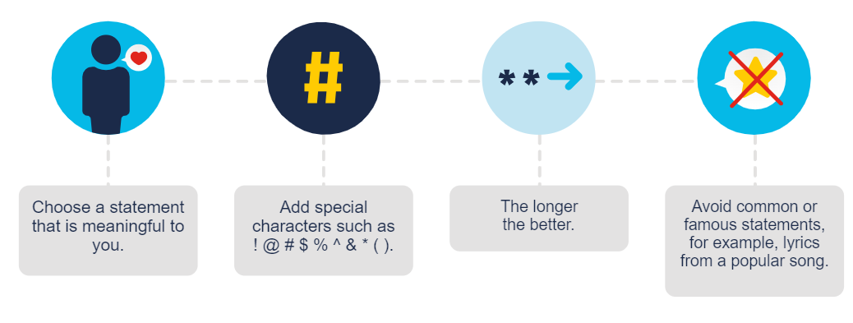

Slide 69
Popular online services, such as Google, Facebook, Twitter, LinkedIn, Apple and Microsoft, use two factor authentication to add an extra layer of security for account logins.
Besides your username and password or personal identification number (PIN), two factor authentication requires a second token to verify your identity. This may be a:
physical object such as a credit card, mobile phone or fob
biometric scan such as a fingerprint or facial and voice recognition
verification code sent via SMS or email.

Slide 70
Open authorization (OAuth) is an open standard protocol that allows you to use your credentials to access third-party applications without exposing your password.

Slide 71
The Internet is a great tool for not only accessing information quickly and easily but also for communicating with friends, family and colleagues. But did you know that anyone with physical access to your device or router can view what websites you’ve visited? And that every time you send an email, it is readable by anyone who has access to the digital chain between you and your recipient?

Slide 72
These problems can be minimized by enabling the in-private browsing mode on your web browser. Many of the most commonly used web browsers have their own name for private browser mode:
Microsoft Internet Explorer: InPrivate
Google Chrome: Incognito
Mozilla Firefox: Private tab or private window
Safari: Private browsing

Slide 73
Ethical considerations and responsibilities
Protection of Personal Privacy: Cybersecurity measures often involve accessing and handling personal data. It's crucial to ensure that individuals' privacy rights are respected and that data is handled securely and transparently. This includes obtaining proper consent for data collection and implementing robust encryption and access controls to safeguard sensitive information.
Fairness and Non-discrimination: Cybersecurity measures should be implemented in a manner that is fair and does not discriminate against individuals or groups based on factors such as race, gender, ethnicity, or socio-economic status. Biases in algorithms or security protocols can lead to unequal treatment or exclusion, which raises ethical concerns.

Slide 74
Transparency and Accountability: Organizations responsible for cybersecurity must be transparent about their practices and accountable for any breaches or failures. This entails providing clear information about security measures in place, promptly disclosing any security incidents, and taking responsibility for addressing vulnerabilities and improving defenses.
Minimizing Harm: While the primary goal of cybersecurity is to protect against threats, it's essential to consider potential unintended consequences. Security measures should be designed to minimize harm to individuals and organizations, even in the event of a breach or attack. This includes minimizing data loss, preventing disruption to essential services, and avoiding collateral damage to innocent parties.

Slide 75
Cybersecurity in Conflict Situations: In contexts such as cyber warfare or geopolitical tensions, ethical considerations surrounding cybersecurity become even more complex. It's crucial to uphold principles of proportionality, distinguishing between military and civilian targets, and minimizing harm to non-combatants.
Global Implications: The interconnected nature of cyberspace means that cybersecurity practices can have global implications. Actions taken by one entity can impact others around the world. Therefore, ethical cybersecurity practices should take into account the broader global community and strive to promote cooperation, information sharing, and collective defense against cyber threats.
Respect for Intellectual Property: Cybersecurity measures often involve protecting intellectual property, such as proprietary software, algorithms, or trade secrets. It's important to balance the need for protection with principles of fair competition and innovation. Additionally, ethical considerations may arise when conducting activities like vulnerability research or penetration testing, where the boundaries of legality and ethical behavior need to be carefully navigated.
Education and Awareness: Promoting cybersecurity education and awareness is essential to empower individuals and organizations to protect themselves effectively. This includes educating users about best practices for password security, phishing awareness, and the importance of keeping software up to date. Ethical cybersecurity practitioners have a responsibility to contribute to these efforts and to foster a culture of security within their communities.

